Slide 1
M.SC. THESIS · Seminar · ARTIFICIAL INTELLIGENCE & DATA SCIENCE
Zero-Shot Nutrient & Quantity Association
via OCR-Guided Semantic Graph Matching
AUTHOR
EXAMINER
DATE
Moustafa Hamada Matrikelnummer 12401478
Prof. Dr. Andreas Fischer THD — Technische Hochschule Deggendorf
July 2026

Slide 2
01 · THE PROBLEM
Structured extraction of nutritional facts from supplement-label images
The goal: extract the nutritional facts from a photo of a food or supplement label as structured records — one tuple ⟨nutrient, quantity, unit, context⟩ per fact. Recovering it has three steps — plus one constraint:
STEP 1 · DETECT
Find the tokens
OCR reads every piece of text and returns it with a box and a confidence — an unordered bag of tokens.
STEP 2 · CLASSIFY
Type each token
Give every token a role: nutrient, quantity, unit, or context. This says what a token is — not what it belongs to.
STEP 3 · ASSOCIATE
Group into tuples — the hard part
Link each quantity to its nutrient, unit, and context. A label holds many numbers; a single wrong link is a wrong fact.
THE CONSTRAINT
Zero-shot & multilingual
Names span many languages and the layout→data mapping cannot be learned — annotations are for evaluation only.
PaddleOCR → GLiNER → graph v2 · 43.0%
02 / 28

Slide 3
02 · THE OBVIOUS ANSWER
Just hand the photo to a vision–language model
The simplest thing to try today: give the label image straight to a large vision–language model and ask for the tuples. One call does the reading, the role decisions, and the binding all at once.
INPUT
Label photo
→
ONE OPAQUE CALL
End-to-end VLM
read + classify + bind
→
OUTPUT
⟨n, q, u, x⟩
No pipeline to build
No OCR, no classifier, no graph — one model does everything.
No labels needed
Zero-shot out of the box — prompt it and read the JSON back.
Any layout, any language
It can read curved packs, mixed languages, broken tables.
It works, and it is the obvious baseline. So why not stop here?
PaddleOCR → GLiNER → graph v2 · 43.0%
03 / 28

Slide 4
02 · THE CATCH
Costly, a black box — and not even that accurate
The convenience comes at a price. For anything you want to deploy, audit, or trust, the end-to-end model fails on three counts.
EXPENSIVE
A model call per label
~7.5 s / image and a GPU pass every time. Cost and latency scale linearly with volume.
BLACK BOX
No intermediate to inspect
Image goes in, tuples come out. There is no token table, no graph, nothing between to check.
NOT TRANSPARENT
No audit trail
When a tuple is wrong, you cannot say which stage failed — reading, role, or binding.
36.0%
And it is not even the most accurate
The end-to-end VLM reaches only 36.0% four-field tuple F1 on this benchmark — it must read, type, and bind in one shot, and OCR-style errors compound. So: opaque, slow, costly — and beatable.
PaddleOCR → GLiNER → graph v2 · 43.0%
04 / 28

Slide 5
02 · OUR ANSWER
A modular pipeline — comparable accuracy, fully transparent
Instead of one opaque model, build an explicit graph over zero-shot-classified OCR tokens, where edges are decided by closed-form geometric and structural rules — not learned weights. Relational power without supervision, every decision open to inspection.
COMPARABLE
43.0% > 36.0%
The best interpretable chain matches — in fact beats — the end-to-end VLM on four-field tuple F1.
CHEAPER
~4.5 s, no model call
The interpretable pipeline never calls a VLM — about 40% faster, no GPU inference per label.
TRANSPARENT
Every tuple is a path
Each binding is an edge built by a rule you can read — so a wrong tuple can be traced to one stage.
A second variant frees a VLM for the association sub-task only — the model’s flexibility used where it pays, the rest kept interpretable.
PaddleOCR → GLiNER → graph v2 · 43.0%
05 / 28

Slide 6
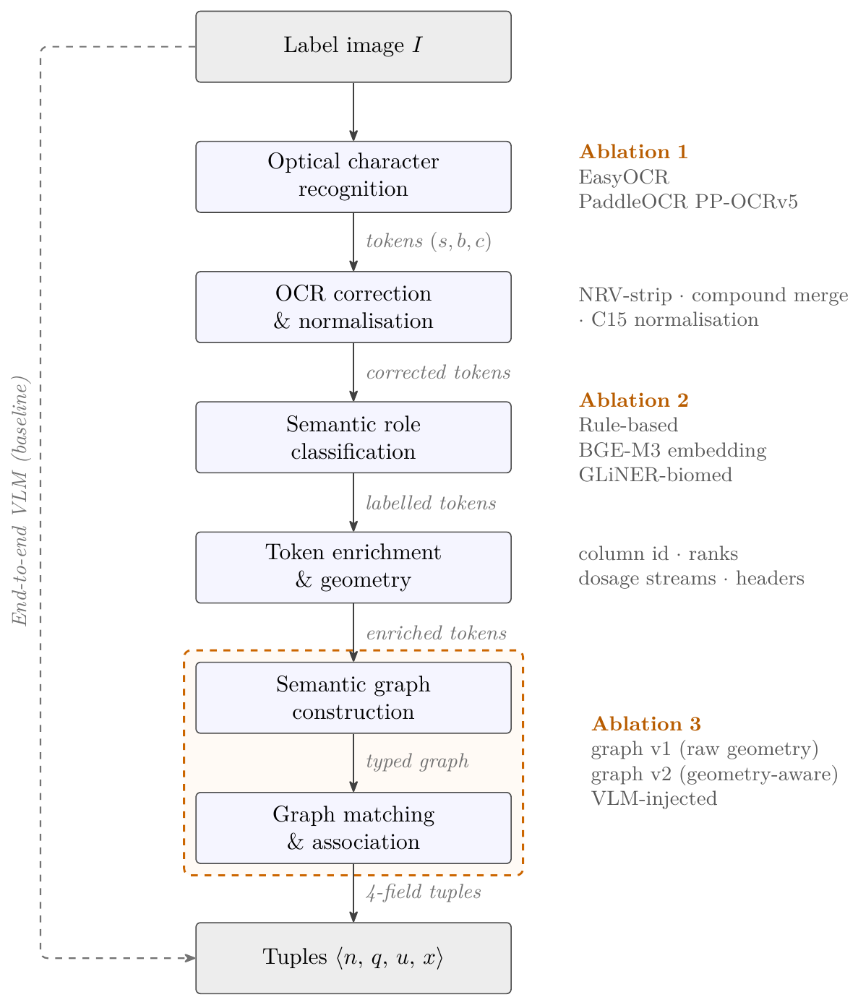
03 · THE PIPELINE
Three stages: OCR → classification → association
Three independently swappable, individually measurable stages — exactly what makes the per-stage ablation possible. The thesis figure (right) maps each stage to its ablated variants.
STAGE 1 · OCR
Read & correct tokens
STAGE 2 · CLASSIFY
Semantic role per token
STAGE 3 · ASSOCIATE — the novelty
Typed graph → tuples
PaddleOCR → GLiNER → graph v2 · 43.0%
06 / 28

Slide 7
03 · THE HEADLINE RESULT
Interpretable pipeline vs. the pure VLM
Same 57-image benchmark (866 gold tuples), same deterministic scorer. The interpretable chain is more accurate, faster, and fully inspectable.
OURS · BEST INTERPRETABLE (E2-C)
BASELINE · PURE END-TO-END VLM (E4)
PaddleOCR → GLiNER → graph v2 · overlap
image → Gemma 3 4B → tuples · no pipeline
43.0%
PRECISION
RECALL
36.0%
PRECISION
RECALL
0.4634
0.4018
0.4228
0.3129
TRUE HITS
FALSE POS.
TRUE HITS
FALSE POS.
4-field tuple F1
348
403
4-field tuple F1
271
370
4.50 s
per image
0
VLM calls
✓
inspectable
7.53 s
per image
1
VLM call/img
✕
black box
+6.4 pts F1, +77 more correct tuples, ~40% faster, and transparent. Ours predicts more (751 vs 641) so it carries a few more false positives, but converts far more gold tuples. The 49.5% embedding+VLM hybrid scores higher still — at 13.7 s/image and a black-box binding step.
PaddleOCR → GLiNER → graph v2 · 43.0%
07 / 28

Slide 8
04 · EVALUATION DATASET
57 labels, 866 nutritional facts — every image is a test image
A zero-shot benchmark of photographed and supplier-provided nutrition & supplement labels. Nothing is held out for training — all 57 images are evaluation-only, scored by one deterministic evaluator.
57
label images
866
gold tuples
15.2
mean tuples/image · max 48
62
unique nutrients
0
used for training
CONTEXT DISTRIBUTION
SINGLE- VS MULTI-CONTEXT
per_100g
44.0%
20 images · 159 tuples
one reference basis (single-context)
per_serving
37.3%
per_daily_dose
15.0%
37 images · 707 tuples
two or more bases (multi-context) — 82% of all facts
per_100ml
3.7%
Units: g 56% · mg 20% · kcal 9% · kJ 9% · μg 5% · NRV % on 175 rows · serving size on 499.
Why this split matters: multi-context labels are exactly where graph v2’s HEADER_SCOPE earns its gain — and they carry most of the tuples.
PaddleOCR → GLiNER → graph v2 · 43.0%
08 / 28

Slide 9
04 · THE CONFIGURATION SPACE
14 configurations — the ablation tree
OCR
CLASSIFIER
ASSOCIATION · MODE
RUN
4-FIELD TUPLE F1
E2E-VLM
—
end-to-end VLM
E4
0.3597
EasyOCR
rule
graph v2 · overlap
EXP-01
0.1773
PaddleOCR
PP-OCRv5
Rule-based
graph v2 · overlap
E2-A
0.4231
VLM association
A_VLM
0.4819
Embedding
(BGE-M3)
graph v1
E3-EMB-G1
0.2325
graph v2 · overlap
E2-B
0.4025
graph v2 · cy-cx
exp39d
0.3860
graph v2 · cy∪role_rank
exp39f
0.3190
graph v2 · role_rank
exp39c
0.1320
VLM association
E3-EMB-VLM
0.4945
★ best overall
GLiNER
biomed
graph v1
E3-GLiNER-G1
0.2523
graph v2 · overlap
E2-C
0.4304
★ best interpretable
graph v2 · cy-cx
E5-GLiNER-cy
0.4135
VLM association
E3-GLiNER-VLM
0.4446
Tier 1 · interpretable graph
Tier 2 · VLM association
Tier 3 · end-to-end
★ best in tier
PaddleOCR → GLiNER → graph v2 · 43.0%
09 / 28

Slide 10
05 · AXIS 1 — OCR ENGINE
Which engine reads the labels best?
VARIANT A EasyOCR — PyTorch, multilingual
VARIANT B PaddleOCR PP-OCRv5 — + corrector v2
Downstream held fixed (rule classifier, graph v2 · overlap). Nutrient is F1; quantity / unit / context are accuracy over matched nutrients.
OCR engine | Nutrient F1 | Quantity acc | Unit acc | Context acc | 4F-F1
EasyOCR (EXP-01) | 0.6773 | 0.4547 | 0.5168 | 0.6141 | 0.1773
PaddleOCR PP-OCRv5 (E2-A) | 0.7239 | 0.7691 | 0.8121 | 0.8726 | 0.4231
Difference | +0.047 | +0.314 | +0.295 | +0.259 | +0.246
Answer. Both engines find names about equally; PaddleOCR wins on reading values (+31 / +30 / +26 pts on quantity / unit / context). Because a tuple needs all four fields, that more than doubles 4F-F1 (0.1773 → 0.4231). PaddleOCR is fixed for every later run.
PaddleOCR → GLiNER → graph v2 · 43.0%
10 / 28

Slide 11
06 · AXIS 2 — CLASSIFIER · THE VARIANTS
Three ways to decide “is this a nutrient?”
All three share the entire deterministic cascade (quantity, unit, context, NRV, noise). They differ only on the final nutrient / not-nutrient decision — precision and recall trade off in opposite directions.
CURATED · NOT ZERO-SHOT
Rule-based lexicon
A curated multilingual nutrient dictionary + supporting heuristics (substring, vitamin forms, slash forms). Highest recall (0.725) — but closed-vocabulary.
ZERO-SHOT
BGE-M3 embedding
Cosine similarity to nutrient prototypes. Accepts by meaning, so highest learned recall (0.698) — but lowest precision (0.658).
ZERO-SHOT · RECOMMENDED
GLiNER-biomed
Zero-shot span detection on the leftover candidates. Highest precision (0.735), lowest recall — few non-nutrients reach the graph.
The next three slides open up the two learned, zero-shot classifiers — how each works, and how their thresholds were chosen.
PaddleOCR → GLiNER → graph v2 · 43.0%
11 / 28

Slide 12
06 · AXIS 2 — EMBEDDING CLASSIFIER
How the embedding classifier works (BGE-M3)
Keeps the deterministic cascade unchanged; replaces only the final lexicon decision with a semantic similarity test. Encoder: BAAI/bge-m3 — XLM-RoBERTa backbone, dense vectors, 100+ languages. No training on the label set.
1 Prototype phrases — a “nutrient” positive category plus non-nutrient negative anchors (125 prototypes, 5 categories).
2 Row-context encoding — each candidate is encoded with nearby row neighbours (e.g. “Fett 12.5 g”), not as an isolated word.
3 Cosine score — compare the candidate to each category’s prototypes; the highest cosine is that category’s score.
4 Accept rule — label nutrient only if nutrient-similarity ≥ threshold AND it beats the best non-nutrient by a margin — else unknown.
TWO OPERATING MODES
Embedding-only vs. hybrid
Embedding-only: all candidates decided by the encoder. Hybrid: the lexicon keeps its positive matches, the encoder only recovers the unknowns.
COST
Runs on CPU
BGE-M3 encodes the candidate tokens locally; no GPU required for the embedding node.
PaddleOCR → GLiNER → graph v2 · 43.0%
12 / 28

Slide 13
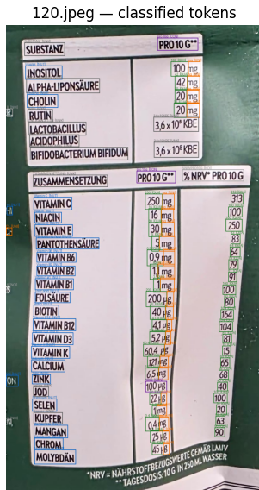
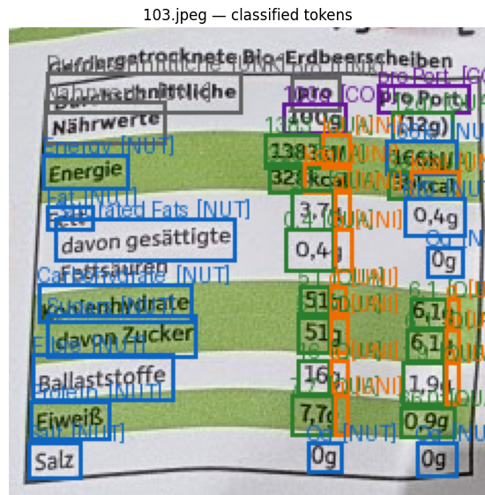
06 · AXIS 2 — CLASSIFIER IN ACTION
The embedding classifier’s token labels
BGE-M3 token classification on two real labels. Each detected token is boxed and coloured by its predicted role — the four roles are exactly the four scored tuple fields.
PREDICTED ROLE
nutrient
quantity
unit
context
Quantity, unit and context are resolved by the shared cascade; only nutrient is the classifier’s call.
(a) dense supplement panel · 120.jpeg
(b) standard nutrition table · 103.jpeg
PaddleOCR → GLiNER → graph v2 · 43.0%
13 / 28

Slide 14
06 · AXIS 2 — GLINER CLASSIFIER
How GLiNER-biomed works — and why this model
Third variant: Ihor/gliner-biomed-bi-large-v1, used as a zero-shot named-entity recogniser — it takes an entity description at inference time and finds matching spans, with no training on the supplement-label set.
1 Entity description — remaining candidates are passed to GLiNER with one label: “nutritional ingredient or vitamin or mineral”.
2 Span detection — if a candidate is covered by an accepted span for that label → role nutrient; otherwise unknown.
3 One threshold — only a span-acceptance threshold — no margin against negatives (unlike the embedding node).
WHY THIS MODEL
Why GLiNER-biomed bi-large
• Biomedical domain matches nutrient / vitamin / mineral entities.
• bi-large gave stronger zero-shot recall and more stable behaviour on German OCR text than smaller variants.
• Needs no curated lexicon — supports the thesis’s generalisation argument.
PaddleOCR → GLiNER → graph v2 · 43.0%
14 / 28

Slide 15
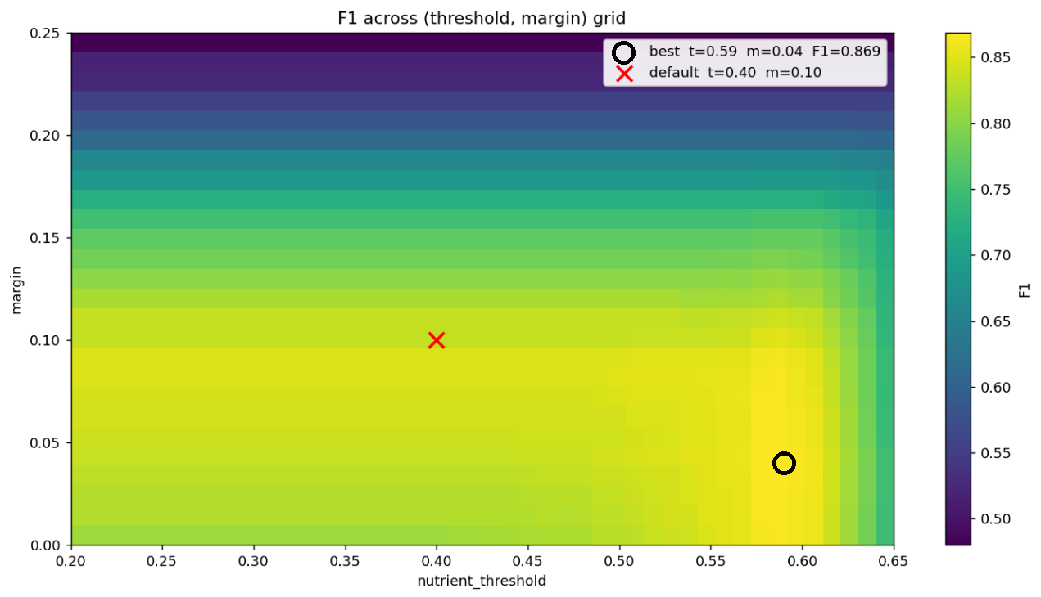
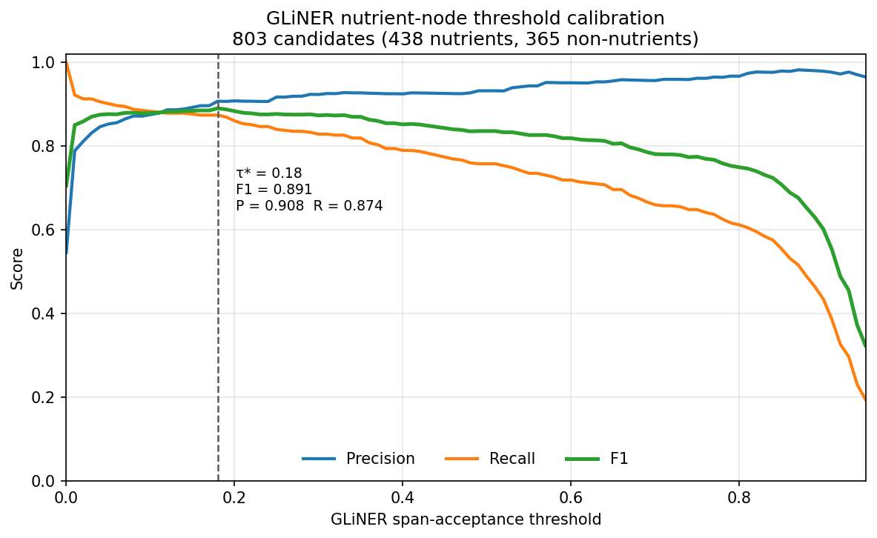
06 · AXIS 2 — THRESHOLD & MARGIN CALIBRATION
How the thresholds and margins were selected
Each learned classifier runs at a fixed operating point chosen by a token-level grid search against manual token labels — the only place either consults labelled data.
BGE-M3 EMBEDDING
Threshold 0.59 · margin 0.04
796 candidate decisions (462 nutrient / 334 non). Small margins (0.01–0.07) work best; token-level F1 ≈ 0.87.
GLINER-BIOMED
Span threshold τ = 0.18
803 candidates (438 / 365). Token F1 ≈ 0.89 (P 0.91, R 0.87). Kept low — the graph can still reject wrong links.
Fig. 3.3 — BGE-M3 threshold–margin heatmap
Fig. 3.4 — GLiNER threshold curve (P / R / F1)
PaddleOCR → GLiNER → graph v2 · 43.0%
15 / 28

Slide 16
06 · AXIS 2 — CLASSIFIER · RESULTS
GLiNER wins the tuple score — on precision
OCR fixed to PaddleOCR, downstream fixed (graph v2 · overlap). The nutrient field is the only one the classifier controls; quantity, unit and context barely move.
Classifier | Nutrient P | Nutrient R | Nutrient F1 | 3F-F1 | 4F-F1
GLiNER-biomed (E2-C · recommended) | 0.7350 | 0.6374 | 0.6827 | 0.4465 | 0.4304
Rule-based lexicon (E2-A) | 0.7227 | 0.7252 | 0.7239 | 0.4415 | 0.4231
BGE-M3 embedding (E2-B) | 0.6580 | 0.6975 | 0.6771 | 0.4204 | 0.4025
Answer. The graph binds whatever candidates it is given. GLiNER’s high precision means few non-nutrients enter, so few false-positive tuples — it tops 4F-F1 at 0.4304 even without the best recall. The embedding classifier’s surplus candidates become false tuples and sink its score. GLiNER is the main zero-shot classifier — best interpretable score, no curated lexicon.
PaddleOCR → GLiNER → graph v2 · 43.0%
16 / 28

Slide 17
07 · AXIS 3 — TOKEN ENRICHMENT & GEOMETRY
Before the graph: enriching tokens with layout
Classification says what each token is; enrichment adds how tokens relate — the missing layout structure the graph needs.
DIRECTION-AWARE GEOMETRY
• Per token: centre (cx, cy), local text angle, a direction vector along the reading line and a normal across it — from the 4-corner polygon when available.
• Same row = near-same direction + close (≈15° tolerance), so slight rotation / curved packs don’t break rows.
• Gap-based grouping: row gap ≈ 25 px, column gap ≈ 60 px, scaled to image size.
STRUCTURAL ATTRIBUTES
• Row & column IDs — a table-like coordinate system.
• Column roles — nutrient-name / value / unit / NRV, inferred from the tokens inside each column.
• Dosage-stream IDs — keep per-100 g vs per-serving value columns separate.
• Header flags, ordinal & role-specific ranks (fallback), and row/column membership confidences.
This enriched representation is exactly what graph v2 consumes — and what graph v1 ignores.
PaddleOCR → GLiNER → graph v2 · 43.0%
17 / 28

Slide 18
07 · AXIS 3 — ASSOCIATION · THE VARIANTS
Four ways to bind tokens into tuples
The thesis contribution and the richest axis. We examine it in three comparisons — graph v1 vs v2, graph v2 vs VLM-association, VLM-association vs end-to-end — then walk the row-edge modes inside graph v2.
① GRAPH V1 · BASELINE
Naive raw-geometry constructor
Recomputes centres from bounding boxes; ignores enrichment. One CONTEXT_SCOPE edge to nutrients only — cannot keep value columns apart.
② GRAPH V2 · GEOMETRY-AWARE
Enriched typed edges + HEADER_SCOPE
Column roles, dosage streams, header flags. HEADER_SCOPE binds each header to its own column → correct per-quantity context. Four row-edge modes.
③ VLM ASSOCIATION
Model binds from injected token table
Interpretable front-end stays; only the binding step is a VLM (Gemma 3 4B) reading the OCR token table + image. Black box only here.
④ END-TO-END VLM
No pipeline at all
The reference from earlier: image → tuples in one opaque call. The fully black-box point we want to beat.
PaddleOCR → GLiNER → graph v2 · 43.0%
18 / 28

Slide 19
07 · AXIS 3 — GRAPH V1 · NODES & EDGES
Graph v1 — the naive constructor
Nodes = non-noise tokens, centre recomputed from the bounding box. Works on raw geometry only — ignores all enrichment (row/col IDs, column roles, ranks, dosage streams, headers). Four edge types:
SAME_ROW — two tokens with similar vertical centres, within a ~25 px row band.
BASELINE LIMITATION
Coordinates, not structure
All thresholds are pixel distances scaled by image height. Simple and inspectable, but it cannot tell apart different sources of row/col evidence — and CONTEXT_SCOPE reaches nutrients only, so it fails on multi-column labels.
SAME_COL — tokens whose horizontal centres are close, within a narrower ~20 px band.
ADJACENT — boxes within ~60 px when no row/col edge exists — a fallback for OCR-shifted units.
CONTEXT_SCOPE — directed: a context token → nutrient nodes below it, within ~600 px.
PaddleOCR → GLiNER → graph v2 · 43.0%
19 / 28

Slide 20
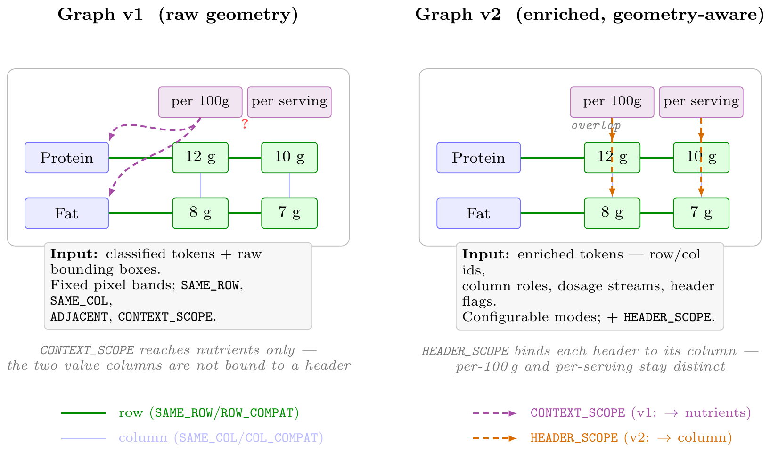
07 · AXIS 3 — GRAPH V2 · NODES & EDGES
Graph v2 — the geometry-aware constructor
Nodes keep text, role, geometry, row/col IDs, column role, ranks, dosage-stream ID and header flag. Richer nodes → four typed edges, each just linking two tokens:
ROW_COMPAT — same row: links a nutrient to the values on its line.
COL_COMPAT — same column: links values stacked in one column.
DIRECTIONAL_ADJ — value → unit: links a number to the unit beside it.
HEADER_SCOPE — by column: binds only its own column, so side-by-side headers (per 100 g vs per serving) stay separate. (v2 novelty)
Fig. 3.5 — graph v1 (header reaches nutrients only) vs graph v2 (header bound to its own column)
Associator extensions: per-quantity context · dosage-stream matching · unit refinement · energy-aware filtering (kJ/kcal).
PaddleOCR → GLiNER → graph v2 · 43.0%
20 / 28

Slide 21
07 · AXIS 3 — CHOOSING THE ROW RULE
How we arrived at the row edge: an incremental story
The ROW_COMPAT edge decides which quantity belongs to which nutrient. We did not start at the answer — we got there by ruling options out.
1 · cy
geometric centre
Link tokens whose vertical centres are within ≈25 px. Simple and strong — but the band is a fixed pixel threshold.
2 · role_rank
structural ordinal
Wanted a rule free of rotation / curved tables: pair the k-th nutrient with the k-th quantity by position. No geometry needed.
3 · cy ∪ role_rank
late-fusion merge
Keep cy, add only role_rank’s unique tuples to recover missed rows. The benefit was not worth the cost.
4 · overlap
geometric ratio
cy’s threshold is resolution-dependent. Replace the pixel band with a scale-free ratio: shared vertical extent ≥ 0.30 of the shorter span.
→
→
→
38.6% 4F-F1
13.2% — failed
31.9% — worse
42.3% — best
The thesis keeps all four as an ablation — the journey is the argument: geometric row detection is a necessary component, not an interchangeable choice.
PaddleOCR → GLiNER → graph v2 · 43.0%
21 / 28

Slide 22
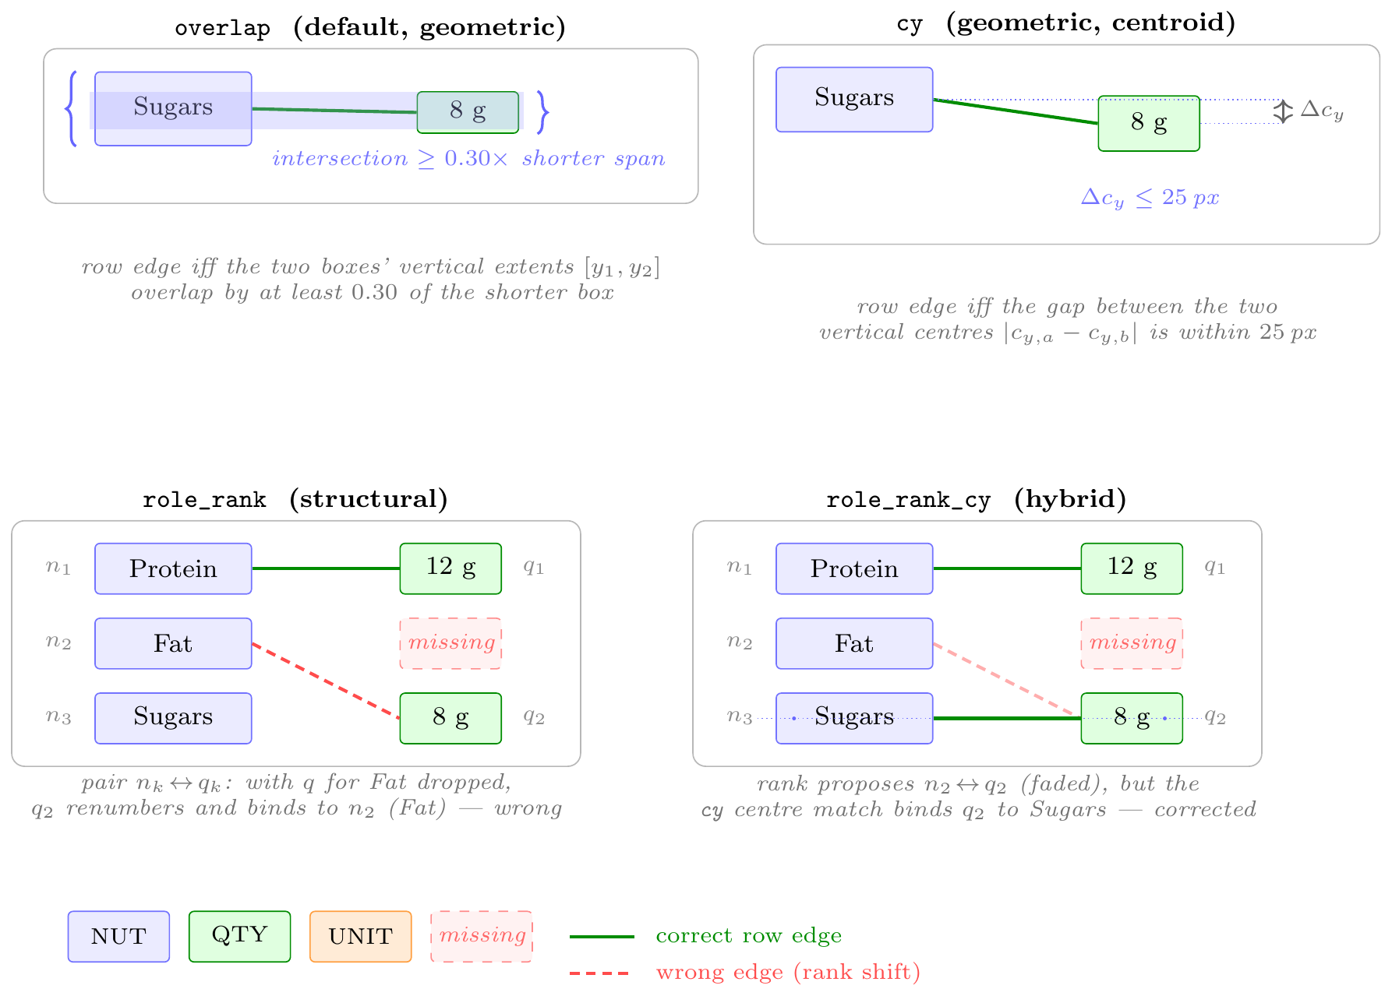
07 · AXIS 3 — WHY ROLE_RANK (AND THE MERGE) FAIL
role_rank breaks on quantity; merging only adds false positives
Row mode | Qty | Unit | 4F-F1 | Hits
cy (geometric) | 76.3% | 82.4% | 38.6% | 353
role_rank | 29.0% | 62.1% | 13.2% | 103
cy ∪ role_rank | 73.9% | 79.2% | 31.9% | 366
THE MERGE’S “TRUE-HITS” EFFECT (cy ∪ role_rank vs cy)
tuples added
+467
actually correct
+13
Mechanism. role_rank pairs the k-th nutrient with the k-th quantity — correct only if both columns have equal, ordered cardinality. One dropped/fused/spurious token shifts every pairing below it. Units repeat (mg, mg…) so they look fine; quantities are all distinct, so the shift shows. ~97% of the merge’s 467 additions are false positives → precision collapses.
Fig. 3.6 — the four row modes on a dropped-quantity row (q₂ for Fat missing)
PaddleOCR → GLiNER → graph v2 · 43.0%
22 / 28

Slide 23
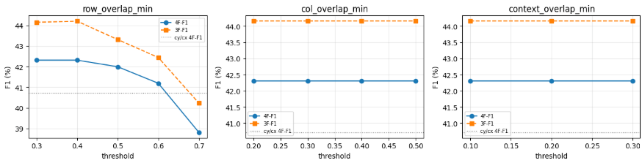
07 · AXIS 3 — FROM CY TO OVERLAP
A row rule with no pixel constant to tune — and it wins
THE PROBLEM WITH cy
cy fires when |cy,a − cy,b| ≤ ~25 px. The real problem is the number itself: 25 px for a row, ~60 px for a column — arbitrary pixel constants with no principled way to choose them. The right value shifts with font size, image resolution and row spacing, and it still compares only centres, so tokens of different heights on one line get missed.
THE OVERLAP RULE
A row edge is created when the intersection of the two boxes’ vertical spans [y1, y2] covers at least 0.30 of the shorter span. A scale-free ratio — no arbitrary pixel constant to pick. It self-scales to each pair of boxes, so it is robust to font size, token height and image resolution alike.
Fig. 3.7 — coordinate-descent over the three overlap thresholds: row 0.30 is decisive; column 0.20 and context 0.10 are flat.
Why overlap is the default. It reads the row directly off page geometry (like cy) but as a proportion, so it is invariant to resolution and to unequal token heights. The sweep confirms the row threshold is the one decisive knob; column and context overlap are nearly flat — a clean, defensible operating point.
GLiNER · graph v2 | 4F-P | Ctx | 4F-F1
overlap (E2-C) | 0.4634 | 0.879 | 0.4304
cy-cx (E5-GLiNER-cy) | 0.4325 | 0.848 | 0.4135
overlap beats cy/cx on the same evaluator: +1.7 pp 4F-F1, +3 pp precision, +3 pp context.
PaddleOCR → GLiNER → graph v2 · 43.0%
23 / 28

Slide 24
07 · ASSOCIATION ① — GRAPH V1 VS GRAPH V2
Graph v2 nearly doubles the score — all on context
Configuration | 3F-F1 | 4F-F1
Embedding · graph v1 | 0.3427 | 0.2325
Embedding · graph v2 | 0.4204 | 0.4025
GLiNER · graph v1 | 0.3705 | 0.2523
GLiNER · graph v2 | 0.4465 | 0.4304
Answer. The jump appears for both classifiers, so it is the graph. The 3F→4F gap collapses from 0.110→0.018 (emb) and 0.118→0.016 (GLiNER). On multi-context labels (37 imgs, 707 tuples) 4F recall nearly doubles — 0.181→0.375 (GLiNER), 0.187→0.390 (embedding) — while single-context is unchanged (0.497→0.522). HEADER_SCOPE is the cause.
PaddleOCR → GLiNER → graph v2 · 43.0%
24 / 28

Slide 25
07 · ASSOCIATION ② — GRAPH V2 VS VLM-ASSOCIATION
A VLM binder lifts precision — for every classifier
Swap only the binding step: graph v2 → Gemma 3 4B reading the same injected token table. OCR and classifier held fixed.
Classifier | Association | 4F-P | 4F-R | 4F-F1 | Δ P
Rule-based | graph v2 (E2-A) | 0.4223 | 0.4238 | 0.4231 | —
Rule-based | VLM assoc. (A_VLM) | 0.5732 | 0.4157 | 0.4819 | +0.15
Embedding | graph v2 (E2-B) | 0.3911 | 0.4145 | 0.4025 | —
Embedding | VLM assoc. (E3-EMB-VLM · best) | 0.6054 | 0.4180 | 0.4945 | +0.21
GLiNER | graph v2 (E2-C) | 0.4634 | 0.4018 | 0.4304 | —
GLiNER | VLM assoc. (E3-GLiNER-VLM) | 0.5269 | 0.3845 | 0.4446 | +0.06
Answer. The VLM raises 4F-F1 in every case — entirely through precision (recall barely moves). Biggest gain for embedding (+0.21). The best classifier flips: GLiNER under the graph, embedding under the VLM. Cost: the binding step is now a black box, ~13.7 s/image.
PaddleOCR → GLiNER → graph v2 · 43.0%
25 / 28

Slide 26
07 · ASSOCIATION ③ — VLM-ASSOC VS END-TO-END VLM
A clean token table beats the raw image
Same model (Gemma 3 4B) binds in both cases. The difference: VLM-association is handed the OCR token table first; end-to-end gets the raw image alone.
Pipeline | 4F-P | 4F-R | 4F-F1 | Time / img
Embedding + VLM (E3-EMB-VLM · best overall) | 0.6054 | 0.4180 | 0.4945 | 13.72 s
Rule + VLM (A_VLM) | 0.5732 | 0.4157 | 0.4819 | ~13 s
GLiNER + VLM (E3-GLiNER-VLM) | 0.5269 | 0.3845 | 0.4446 | ~13 s
End-to-end VLM (E4 · no pipeline) | 0.4228 | 0.3129 | 0.3597 | 7.53 s
Answer. All three VLM-association runs beat the end-to-end model. The token table raises both precision (the model isn’t also making OCR errors) and recall (the front-end recovered tokens it would miss). The best, E3-EMB-VLM at 0.4945, is +0.135 over E4 (0.3597). Structuring the problem before binding is worth more than handing the whole task to one model.
PaddleOCR → GLiNER → graph v2 · 43.0%
26 / 28

Slide 27
08 · ALL 14 RUNS
Complete results
ID | OCR | Classifier | Association | 4F-F1 | Note
E3-EMB-VLM | Paddle | Embedding | VLM assoc. | 0.4945 | best overall
A_VLM | Paddle | Rule | VLM assoc. | 0.4819 | black-box bind
E3-GLiNER-VLM | Paddle | GLiNER | VLM assoc. | 0.4446 | —
E2-C | Paddle | GLiNER | graph v2 · overlap | 0.4304 | best interpretable
E2-A | Paddle | Rule | graph v2 · overlap | 0.4231 | highest recall
E5-GLiNER-cy | Paddle | GLiNER | graph v2 · cy-cx | 0.4135 | overlap +1.7pp
E2-B | Paddle | Embedding | graph v2 · overlap | 0.4025 | best emb row
exp39d | Paddle | Embedding | graph v2 · cy-cx | 0.3860 | —
E4 | — | — | end-to-end VLM | 0.3597 | bypasses pipeline
exp39f | Paddle | Embedding | graph v2 · merged | 0.3190 | union wrecks P
E3-GLiNER-G1 | Paddle | GLiNER | graph v1 | 0.2523 | legacy graph
E3-EMB-G1 | Paddle | Embedding | graph v1 | 0.2325 | legacy graph
EXP-01 | EasyOCR | Rule | graph v2 · overlap | 0.1773 | OCR baseline
exp39c | Paddle | Embedding | graph v2 · role_rank | 0.1320 | ordinal brittle
PaddleOCR → GLiNER → graph v2 · 43.0%
27 / 28

Slide 28
09 · CONCLUSION
Interpretable, zero-shot, and competitive
CONTRIBUTIONS
A modular, fully zero-shot pipeline recovering ⟨nutrient, quantity, unit, context⟩ from label photos across languages.
Graph v2 with closed-form geometric/structural edges — relational power without supervision; HEADER_SCOPE nearly doubles multi-context recall.
A VLM-as-associator variant that uses the model only where it pays, keeping the front-end interpretable.
A reproducible 57-image / 866-tuple benchmark with a deterministic evaluator.
HEADLINE RESULT
43.0%
best interpretable 4F-F1, fully zero-shot
PaddleOCR → GLiNER → graph v2 · overlap
beats the end-to-end VLM (36.0%), ~40% faster, fully transparent
LIMITATIONS & FUTURE WORK
Greedy local association — no global one-to-one resolution.
Small single-domain corpus; OCR is still the dominant error source.
Next: larger multilingual corpora, learned-but-inspectable edge scoring, global matching.
Thank you
Questions & discussion welcome.
PaddleOCR → GLiNER → graph v2 · 43.0%
28 / 28

